Slide 1
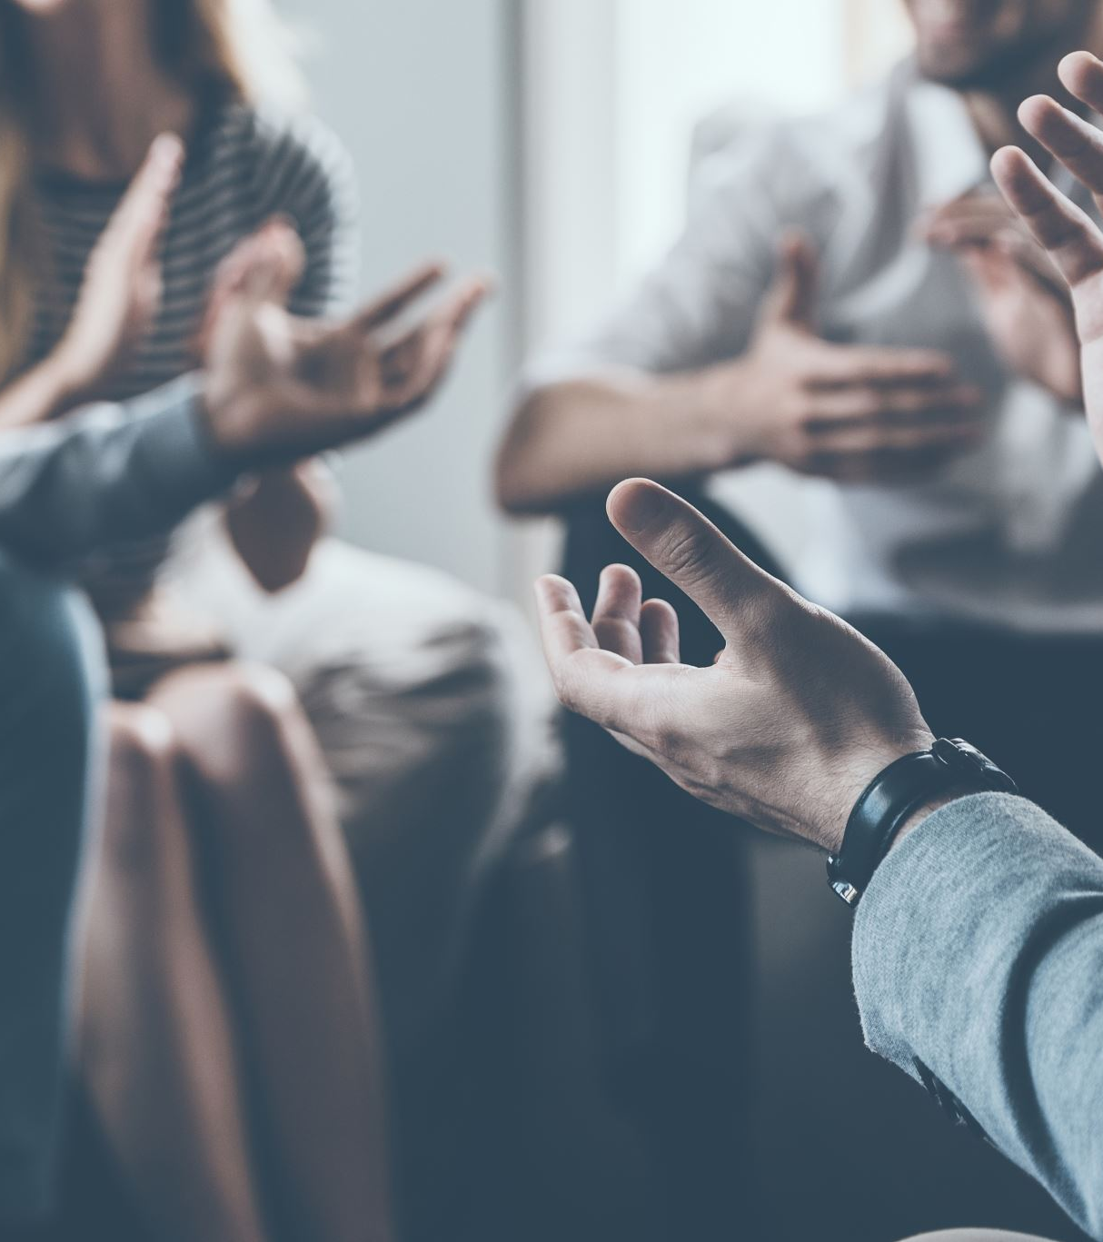
Implicit Bias:
Let's Talk About It!
A Community Conversation
January 22, 2024 (12:30 PM - 02:00 PM)
FIMR Community Action Team

Slide 2
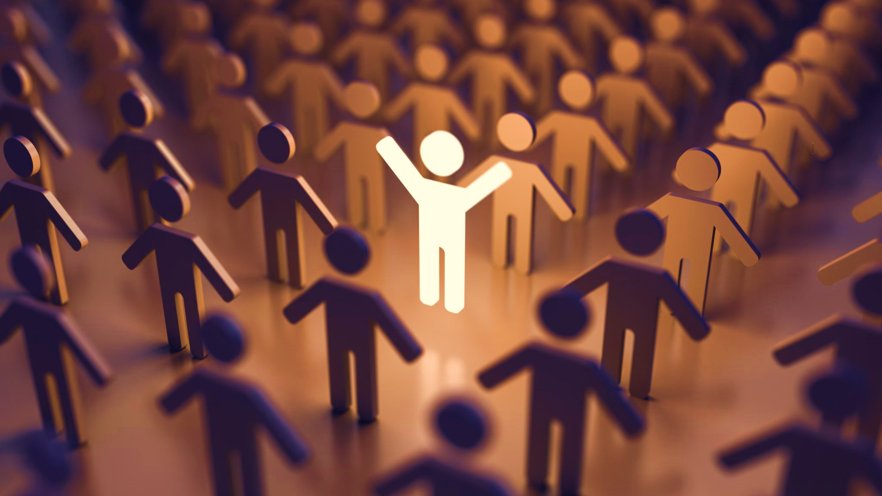
Respect Everyone-Ground Rules
Speak Your Truth
Seek to Understand
Respect Others’ Experience
Disagree Without Conflict
Make room for all voices to be heard, don’t dominate the conversation.
Confidentiality
Take Care of Yourself
How to Participate
ZOOM:
Please feel free to use the Chat function to share your thoughts during the conversation and ask questions
If you would like to come off mute, please raise your hand.
In-Person:
Raise your hand if you want to make a comment or would like to ask a question.
Notes:
Speak Your Truth: Share from your own experiences
Seek to Understand: Actively listen, before responding
Respect Others’ Experience: We may have different OR similar stories to share, and contexts to draw from. All are legitimate.
Disagree Without Discord: Disagreement is expected. HOWEVER,
Approach unexpected ideas with curiosity, not argument.
If you disagree, debate and challenge ideas. Don’t attack the speaker.
Share the Air: Make room for all voices to be heard, and don’t dominate the conversation.
Confidentiality:
Share stories and experiences, but don’t identify individual people or provide details that would allow someone in your story to be identified.
Do not share the experiences you hear in this space outside this space.
Take Care of yourself: We recognize that talking about implicit bias may be difficult for some. If you find the conversation too hard to listen to, please make sure to remove yourself from the situation and reconnect with us after to see how your voice can help support the work we are trying to do.
https://www.umass.edu/diversity/Verne-Myers-Session-2-Guide

Slide 3
Implicit Bias: Break it down
Implicit bias refers to the unconscious (or automatic) attitudes or stereotypes that affect how we think, act and make decisions. These are often linked to people based on things like race, ethnicity, sexual orientation, age or looks. These links form over a lifetime.
Everyone has implicit biases
They can be good or bad
Our implicit biases do not always reflect our values or thoughts
Implicit biases can be changed and managed by new experiences and our efforts to address how we act.
Notes:
Why are we here? - We recognize implicit bias exists and we want to manage the negative impacts. One step is to name it as a community and challenge it when we see its impact.

Slide 4
Themes brought up at our last conversation
Regardless of the person, implicit bias presents itself in many different ways in many different interactions we have
Long-term consequences of actions guided by implicit bias beliefs and the real world cost it has on us.
Discussed the need to continually ask questions, bring in a support team, seek out advocates, organize and prepare questions ahead of appointments, build relationships, and consider when it’s time to change providers.
Discussed the need for ongoing, consistent, intentional efforts to make any changes. Risk of sliding back to status quo if we “take the foot off the gas.”
Impact that negative labeling language has and the lasting effects that it has when we access care.

Slide 5
Our Panel
Will is currently the Male Involvement CHW Specialist with UIC -Healthy Start. UIC-Healthy Start is one of the 100 plus government funded programs across the country. We provide case-management, wrap around social services, and support to families with children 18 months and younger. He works directly with the Fathers enrolled in the program via the Brotherly H.U.B fatherhood service offerings. Although he is new to this space professionally, He is not new to being a Father, a caring community member, and an advocate for health equity. In his role he feel like he has truly connected his passion with his purpose.
Willie M. Naugles Jr.
Advocate

Slide 6
Our Panel
Patricia Ceja-Muhsen has been a community certified birth doula for the past 12 years. She currently works as a Doula and Outreach Manager for Healthy Parents & Babies. Part of her work includes working with low income pregnant/early postpartum families in the City of Chicago and doing community outreach.
Patricia Ceja-Muhsen Advocate

Slide 7
What's next? Community Aimed Action
Hold a systems, policy makers, networks conversation on this topic. Share what has been learned from the community over the last year and invite them to collaborate with us on actions
Aim to hold event on Q1 2024
Create opportunities to ask questions and gain support for action moving forward
Invite them to participate in a community conversation
Continue these community conversations and aim to hold a conversation in 2024 to start developing strategies to help support our communities
LET'S CONTINUE THIS CONVERSATION AND SHIFT TO ACTION!

Slide 8
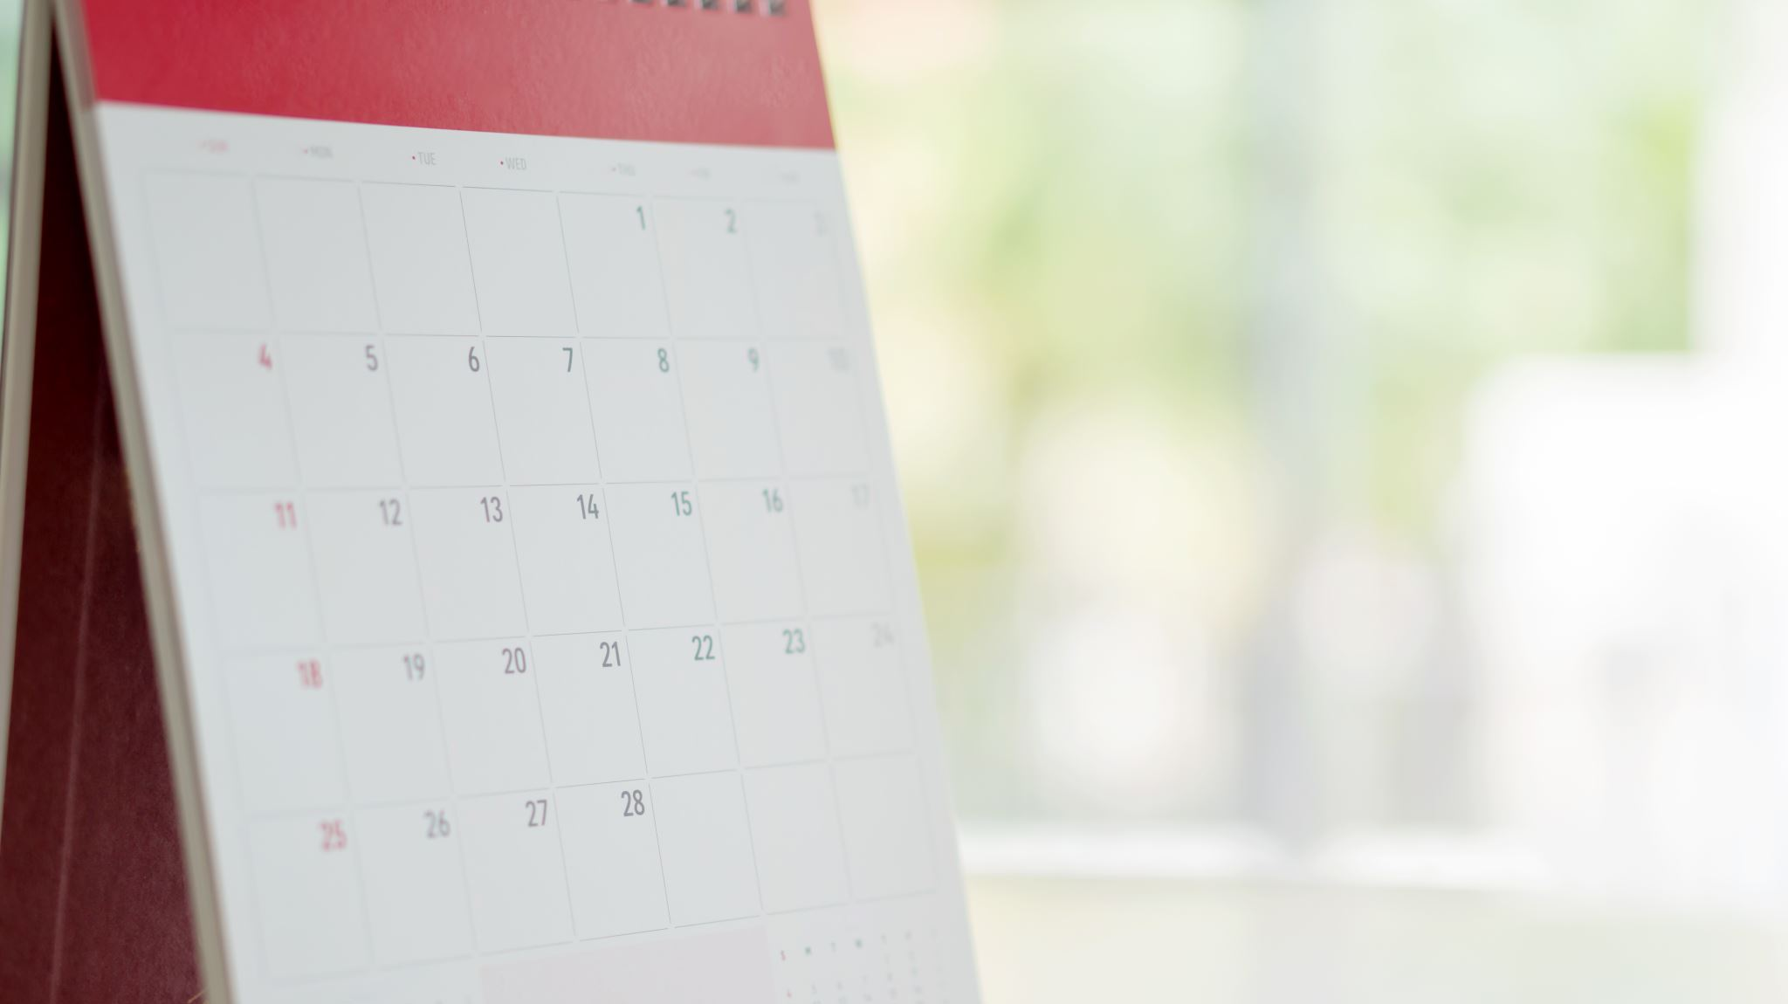
Save the Date!
Continue this conversation with us!
April 22, 2024 (12:30 PM to 02:00 PM)

Slide 9
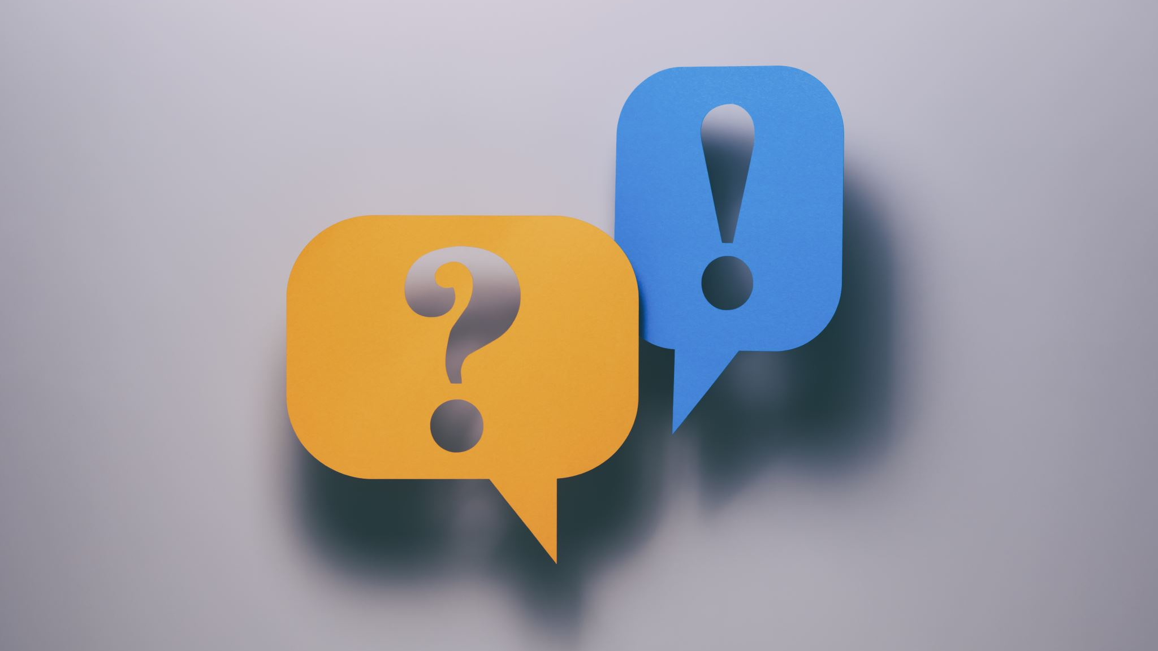
Questions or Comments-Let us know! Website: https://www.fimrchicago.org/implicitbias Email: fimr@bsd.uchicago.edu

